Slide 1

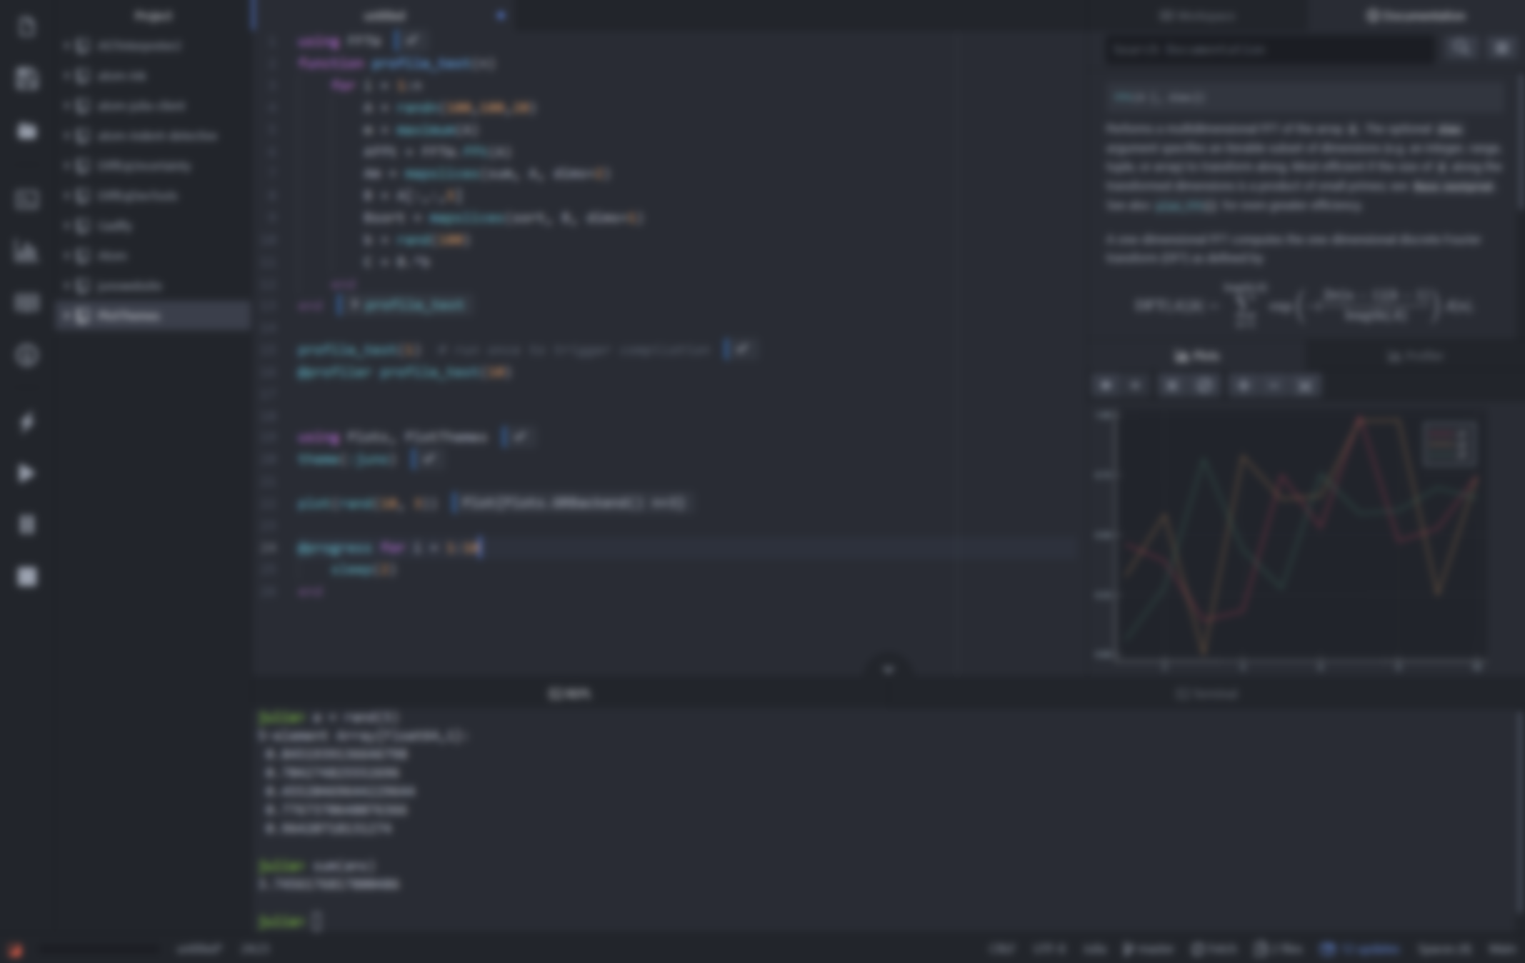
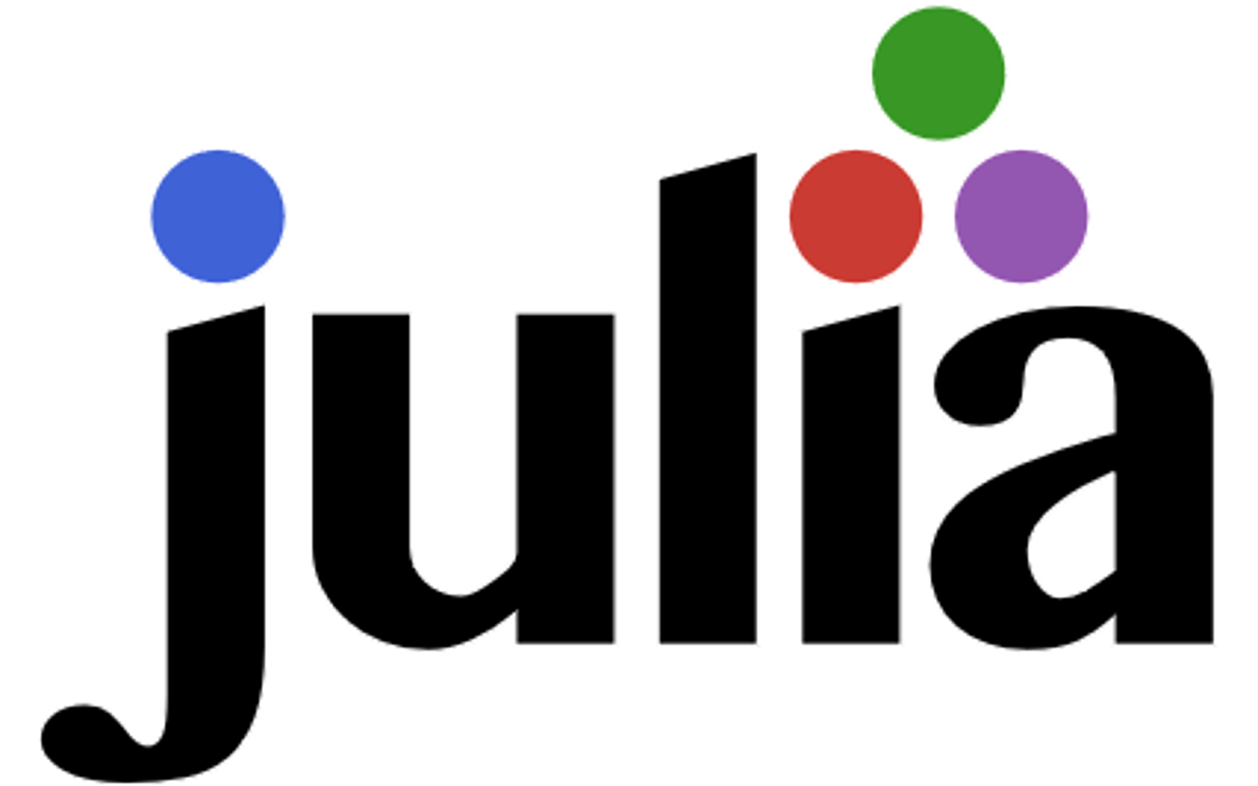


Julia Workshop
Carsten Bauer @ University of Oulu, Finnland, February 2020

Slide 2
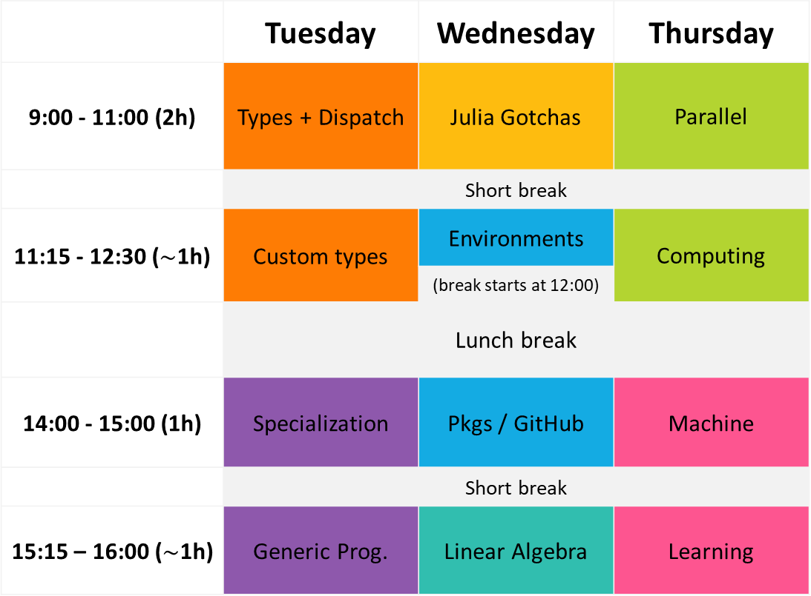
 | Tuesday | Wednesday | Thursday
9:00 - 11:00 (2h) | Types + Dispatch | Julia Gotchas | Parallel
 | Short break
11:15 - 12:30 ($\sim$1h) | Custom types | Environments | Computing
 |  | (break starts at 12:00)
 | Lunch break
14:00 - 15:00 (1h) | Specialization | Pkgs / GitHub | Machine
 | Short break
15:15 – 16:00 ($\sim$1h) | Generic Prog. | Linear Algebra | Learning

Slide 3
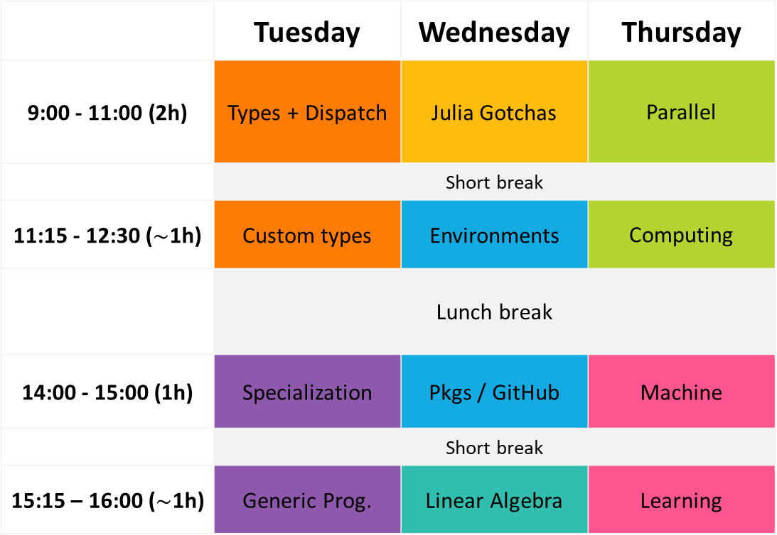
 | Tuesday | Wednesday | Thursday
9:00 - 11:00 (2h) | Types + Dispatch | Julia Gotchas | Parallel
 | Short break
11:15 - 12:30 ($\sim$1h) | Custom types | Environments | Computing
 | Lunch break
14:00 - 15:00 (1h) | Specialization | Pkgs / GitHub | Machine
 | Short break
15:15 – 16:00 ($\sim$1h) | Generic Prog. | Linear Algebra | Learning

Slide 4
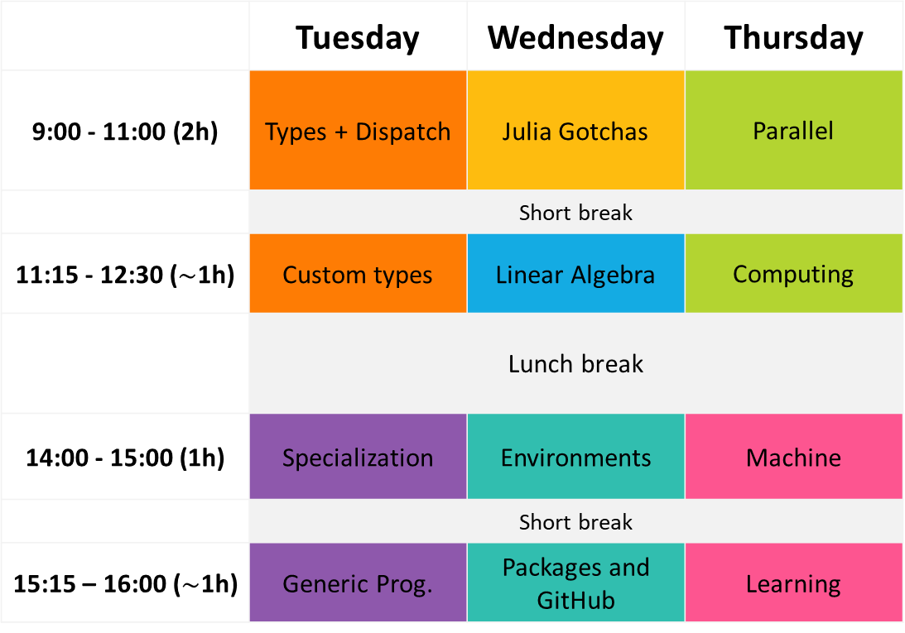
 | Tuesday | Wednesday | Thursday
9:00 - 11:00 (2h) | Types + Dispatch | Julia Gotchas | Parallel
 | Short break
11:15 - 12:30 ($\sim$1h) | Custom types | Linear Algebra | Computing
 | Lunch break
14:00 - 15:00 (1h) | Specialization | Environments | Machine
 | Short break
15:15 – 16:00 ($\sim$1h) | Generic Prog. | Packages and GitHub | Learning

Slide 5

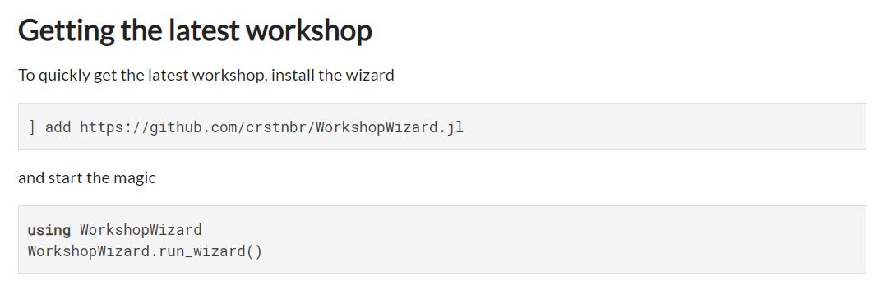
https://github.com/crstnbr/WorkshopWizard.jl

Slide 6
In a Terminal
git clone https://github.com/crstnbr/JuliaOulu20
cd JuliaOulu20
julia install.jl

Slide 7
Interactive part

Slide 8

Disclaimer
This workshop will be opinionated!
This workshop will be incomplete!
The topics will (likely) be too easy and too difficult!
There are other great languages out there!

Slide 9
The Power of Language

Slide 10
The Power of Language
for Performance

Slide 11
The Power of Language
for Productivity

Slide 12
The Power of Language
for Abstraction

Slide 13
The Power of Language
for Community Building

Slide 14
The Power of Language
for Code Reuse

Slide 15
The Power of Language
for Scientific Computing

Slide 16

Vandermonde matrix
vander(x)

Slide 17
numpy.vander(x)

Slide 18
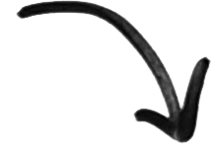
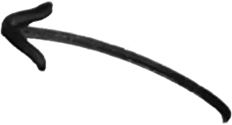
Python
calls
def vander(x, N=None, increasing=False):
x = asarray(x)
if x.ndim != 1:
raise ValueError("x must be a one-dimensional array or sequence.")
if N is None:
N = len(x)
v = empty((len(x), N), dtype=promote_types(x.dtype, int))
tmp = v[:, ::-1] if not increasing else v
if N > 0:
tmp[:, 0] = 1
if N > 1:
tmp[:, 1:] = x[:, None]
multiply.accumulate(tmp[:, 1:], out=tmp[:, 1:], axis=1)
return v
C code
PyUFunc_Accumulate(PyUFuncObject *ufunc, PyArrayObject *arr, PyArrayObject *out,
int axis, int otype)
{
PyArrayObject *op[2];
PyArray_Descr *op_dtypes[2] = {NULL, NULL};
int op_axes_arrays[2][NPY_MAXDIMS];
int *op_axes[2] = {op_axes_arrays[0], op_axes_arrays[1]};
npy_uint32 op_flags[2];
int idim, ndim, otype_final;
int needs_api, need_outer_iterator;
NpyIter *iter = NULL, *iter_inner = NULL;
/* The selected inner loop */
PyUFuncGenericFunction innerloop = NULL;
void *innerloopdata = NULL;
const char *ufunc_name = ufunc_get_name_cstr(ufunc);
/* These parameters come from extobj= or from a TLS global */
int buffersize = 0, errormask = 0;
NPY_BEGIN_THREADS_DEF;
NPY_UF_DBG_PRINT1("\nEvaluating ufunc %s.accumulate\n", ufunc_name);
#if 0
printf("Doing %s.accumulate on array with dtype : ", ufunc_name);
PyObject_Print((PyObject *)PyArray_DESCR(arr), stdout, 0);
printf("\n");
#endif
if (_get_bufsize_errmask(NULL, "accumulate", &buffersize, &errormask) < 0) {
return NULL;
}
/* Take a reference to out for later returning */
Py_XINCREF(out);
otype_final = otype;
if (get_binary_op_function(ufunc, &otype_final,
&innerloop, &innerloopdata) < 0) {
PyArray_Descr *dtype = PyArray_DescrFromType(otype);
PyErr_Format(PyExc_ValueError,
"could not find a matching type for %s.accumulate, "
"requested type has type code '%c'",
ufunc_name, dtype ? dtype->type : '-');
Py_XDECREF(dtype);
goto fail;
}
ndim = PyArray_NDIM(arr);
/*
* Set up the output data type, using the input's exact
* data type if the type number didn't change to preserve
* metadata
*/
if (PyArray_DESCR(arr)->type_num == otype_final) {
if (PyArray_ISNBO(PyArray_DESCR(arr)->byteorder)) {
op_dtypes[0] = PyArray_DESCR(arr);
Py_INCREF(op_dtypes[0]);
}
else {
op_dtypes[0] = PyArray_DescrNewByteorder(PyArray_DESCR(arr),
NPY_NATIVE);
}
}
else {
op_dtypes[0] = PyArray_DescrFromType(otype_final);
}
if (op_dtypes[0] == NULL) {
goto fail;
}
#if NPY_UF_DBG_TRACING
printf("Found %s.accumulate inner loop with dtype : ", ufunc_name);
PyObject_Print((PyObject *)op_dtypes[0], stdout, 0);
printf("\n");
#endif
/* Set up the op_axes for the outer loop */
for (idim = 0; idim < ndim; ++idim) {
op_axes_arrays[0][idim] = idim;
op_axes_arrays[1][idim] = idim;
}
/* The per-operand flags for the outer loop */
op_flags[0] = NPY_ITER_READWRITE |
NPY_ITER_NO_BROADCAST |
NPY_ITER_ALLOCATE |
NPY_ITER_NO_SUBTYPE;
op_flags[1] = NPY_ITER_READONLY;
op[0] = out;
op[1] = arr;
need_outer_iterator = (ndim > 1);
/* We can't buffer, so must do UPDATEIFCOPY */
if (!PyArray_ISALIGNED(arr) || (out && !PyArray_ISALIGNED(out)) ||
!PyArray_EquivTypes(op_dtypes[0], PyArray_DESCR(arr)) ||
(out &&
!PyArray_EquivTypes(op_dtypes[0], PyArray_DESCR(out)))) {
need_outer_iterator = 1;
}
/* If input and output overlap in memory, use iterator to figure it out */
else if (out != NULL && solve_may_share_memory(out, arr, NPY_MAY_SHARE_BOUNDS) != 0) {
need_outer_iterator = 1;
}
if (need_outer_iterator) {
int ndim_iter = 0;
npy_uint32 flags = NPY_ITER_ZEROSIZE_OK|
NPY_ITER_REFS_OK|
NPY_ITER_COPY_IF_OVERLAP;
PyArray_Descr **op_dtypes_param = NULL;
/*
* The way accumulate is set up, we can't do buffering,
* so make a copy instead when necessary.
*/
ndim_iter = ndim;
flags |= NPY_ITER_MULTI_INDEX;
/*
* Add some more flags.
*
* The accumulation outer loop is 'elementwise' over the array, so turn
* on NPY_ITER_OVERLAP_ASSUME_ELEMENTWISE. That is, in-place
* accumulate(x, out=x) is safe to do without temporary copies.
*/
op_flags[0] |= NPY_ITER_UPDATEIFCOPY|NPY_ITER_ALIGNED|NPY_ITER_OVERLAP_ASSUME_ELEMENTWISE;
op_flags[1] |= NPY_ITER_COPY|NPY_ITER_ALIGNED|NPY_ITER_OVERLAP_ASSUME_ELEMENTWISE;
op_dtypes_param = op_dtypes;
op_dtypes[1] = op_dtypes[0];
NPY_UF_DBG_PRINT("Allocating outer iterator\n");
iter = NpyIter_AdvancedNew(2, op, flags,
NPY_KEEPORDER, NPY_UNSAFE_CASTING,
op_flags,
op_dtypes_param,
ndim_iter, op_axes, NULL, 0);
if (iter == NULL) {
goto fail;
}
/* In case COPY or UPDATEIFCOPY occurred */
op[0] = NpyIter_GetOperandArray(iter)[0];
op[1] = NpyIter_GetOperandArray(iter)[1];
if (NpyIter_RemoveAxis(iter, axis) != NPY_SUCCEED) {
goto fail;
}
if (NpyIter_RemoveMultiIndex(iter) != NPY_SUCCEED) {
goto fail;
}
}
/* Get the output */
if (out == NULL) {
if (iter) {
op[0] = out = NpyIter_GetOperandArray(iter)[0];
Py_INCREF(out);
}
else {
PyArray_Descr *dtype = op_dtypes[0];
Py_INCREF(dtype);
op[0] = out = (PyArrayObject *)PyArray_NewFromDescr(
&PyArray_Type, dtype,
ndim, PyArray_DIMS(op[1]), NULL, NULL,
0, NULL);
if (out == NULL) {
goto fail;
}
}
}
/*
* If the reduction axis has size zero, either return the reduction
* unit for UFUNC_REDUCE, or return the zero-sized output array
* for UFUNC_ACCUMULATE.
*/
if (PyArray_DIM(op[1], axis) == 0) {
goto finish;
}
else if (PyArray_SIZE(op[0]) == 0) {
goto finish;
}
if (iter && NpyIter_GetIterSize(iter) != 0) {
char *dataptr_copy[3];
npy_intp stride_copy[3];
npy_intp count_m1, stride0, stride1;
NpyIter_IterNextFunc *iternext;
char **dataptr;
int itemsize = op_dtypes[0]->elsize;
/* Get the variables needed for the loop */
iternext = NpyIter_GetIterNext(iter, NULL);
if (iternext == NULL) {
goto fail;
}
dataptr = NpyIter_GetDataPtrArray(iter);
/* Execute the loop with just the outer iterator */
count_m1 = PyArray_DIM(op[1], axis)-1;
stride0 = 0, stride1 = PyArray_STRIDE(op[1], axis);
NPY_UF_DBG_PRINT("UFunc: Reduce loop with just outer iterator\n");
stride0 = PyArray_STRIDE(op[0], axis);
stride_copy[0] = stride0;
stride_copy[1] = stride1;
stride_copy[2] = stride0;
needs_api = NpyIter_IterationNeedsAPI(iter);
NPY_BEGIN_THREADS_NDITER(iter);
do {
dataptr_copy[0] = dataptr[0];
dataptr_copy[1] = dataptr[1];
dataptr_copy[2] = dataptr[0];
/*
* Copy the first element to start the reduction.
*
* Output (dataptr[0]) and input (dataptr[1]) may point to
* the same memory, e.g. np.add.accumulate(a, out=a).
*/
if (otype == NPY_OBJECT) {
/*
* Incref before decref to avoid the possibility of the
* reference count being zero temporarily.
*/
Py_XINCREF(*(PyObject **)dataptr_copy[1]);
Py_XDECREF(*(PyObject **)dataptr_copy[0]);
*(PyObject **)dataptr_copy[0] =
*(PyObject **)dataptr_copy[1];
}
else {
memmove(dataptr_copy[0], dataptr_copy[1], itemsize);
}
if (count_m1 > 0) {
/* Turn the two items into three for the inner loop */
dataptr_copy[1] += stride1;
dataptr_copy[2] += stride0;
NPY_UF_DBG_PRINT1("iterator loop count %d\n",
(int)count_m1);
innerloop(dataptr_copy, &count_m1,
stride_copy, innerloopdata);
}
} while (iternext(iter));
NPY_END_THREADS;
}
else if (iter == NULL) {
char *dataptr_copy[3];
npy_intp stride_copy[3];
int itemsize = op_dtypes[0]->elsize;
/* Execute the loop with no iterators */
npy_intp count = PyArray_DIM(op[1], axis);
npy_intp stride0 = 0, stride1 = PyArray_STRIDE(op[1], axis);
NPY_UF_DBG_PRINT("UFunc: Reduce loop with no iterators\n");
if (PyArray_NDIM(op[0]) != PyArray_NDIM(op[1]) ||
!PyArray_CompareLists(PyArray_DIMS(op[0]),
PyArray_DIMS(op[1]),
PyArray_NDIM(op[0]))) {
PyErr_SetString(PyExc_ValueError,
"provided out is the wrong size "
"for the reduction");
goto fail;
}
stride0 = PyArray_STRIDE(op[0], axis);
stride_copy[0] = stride0;
stride_copy[1] = stride1;
stride_copy[2] = stride0;
/* Turn the two items into three for the inner loop */
dataptr_copy[0] = PyArray_BYTES(op[0]);
dataptr_copy[1] = PyArray_BYTES(op[1]);
dataptr_copy[2] = PyArray_BYTES(op[0]);
/*
* Copy the first element to start the reduction.
*
* Output (dataptr[0]) and input (dataptr[1]) may point to the
* same memory, e.g. np.add.accumulate(a, out=a).
*/
if (otype == NPY_OBJECT) {
/*
* Incref before decref to avoid the possibility of the
* reference count being zero temporarily.
*/
Py_XINCREF(*(PyObject **)dataptr_copy[1]);
Py_XDECREF(*(PyObject **)dataptr_copy[0]);
*(PyObject **)dataptr_copy[0] =
*(PyObject **)dataptr_copy[1];
}
else {
memmove(dataptr_copy[0], dataptr_copy[1], itemsize);
}
if (count > 1) {
--count;
dataptr_copy[1] += stride1;
dataptr_copy[2] += stride0;
NPY_UF_DBG_PRINT1("iterator loop count %d\n", (int)count);
needs_api = PyDataType_REFCHK(op_dtypes[0]);
if (!needs_api) {
NPY_BEGIN_THREADS_THRESHOLDED(count);
}
innerloop(dataptr_copy, &count,
stride_copy, innerloopdata);
NPY_END_THREADS;
}
}
finish:
Py_XDECREF(op_dtypes[0]);
NpyIter_Deallocate(iter);
NpyIter_Deallocate(iter_inner);
return (PyObject *)out;
fail:
Py_XDECREF(out);
Py_XDECREF(op_dtypes[0]);
NpyIter_Deallocate(iter);
NpyIter_Deallocate(iter_inner);
return NULL;
}
@TYPE@_@kind@(char **args, npy_intp *dimensions, npy_intp *steps, void *NPY_UNUSED(func))
{
if (IS_BINARY_REDUCE) {
#if @PW@
@type@ * iop1 = (@type@ *)args[0];
npy_intp n = dimensions[0];
*iop1 @OP@= pairwise_sum_@TYPE@(args[1], n, steps[1]);
#else
BINARY_REDUCE_LOOP(@type@) {
io1 @OP@= *(@type@ *)ip2;
}
*((@type@ *)iop1) = io1;
#endif
}
else if (!run_binary_simd_@kind@_@TYPE@(args, dimensions, steps)) {
BINARY_LOOP {
const @type@ in1 = *(@type@ *)ip1;
const @type@ in2 = *(@type@ *)ip2;
*((@type@ *)op1) = in1 @OP@ in2;
}
}
}
uses
C template

Slide 19
Julia
function vander(x::AbstractVector{T}) where T
m = length(x)
V = Matrix{T}(undef, m, m)
for j = 1:m
V[j,1] = one(x[j])
end
for i= 2:m
for j = 1:m
V[j,i] = x[j] * V[j,i-1]
end
end
return V
end

Slide 20
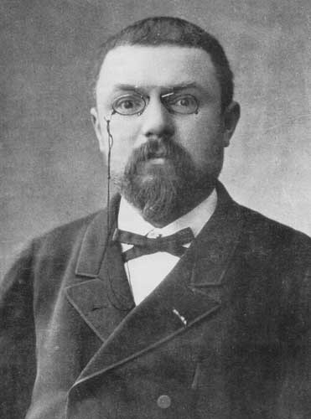
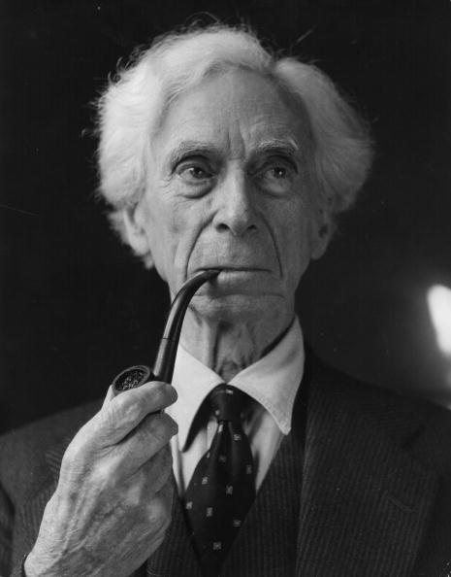
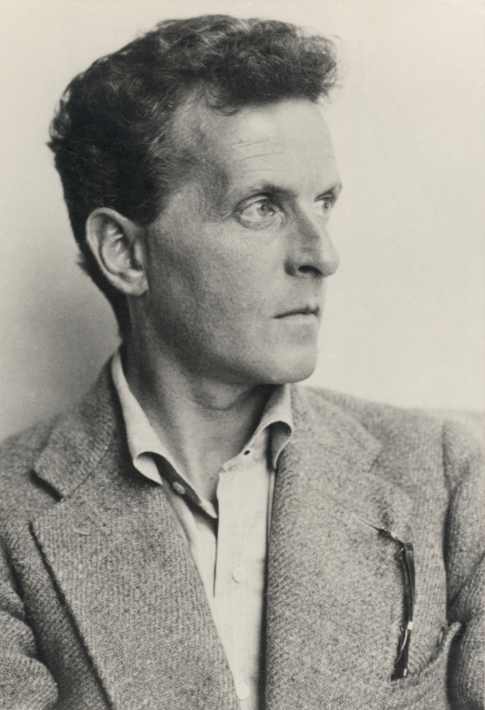
Historical precedent
When language has been well chosen, one is astonished… (in mathematics what’s possible…)
Henri Poincaré
Language serves not only to express thoughts, but to make possible thoughts which could not exist without it.
Bertrand Russell
The limits of my language mean the limits of my world.
Ludwig Wittgenstein

Slide 21


What does science need from a programming language?
Performance
Workflow: roll up sleeves & performance engineer

Slide 22
What does science need from a programming language?
Easy to write and read
Fast and scalable
Interactive

Slide 23

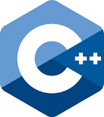
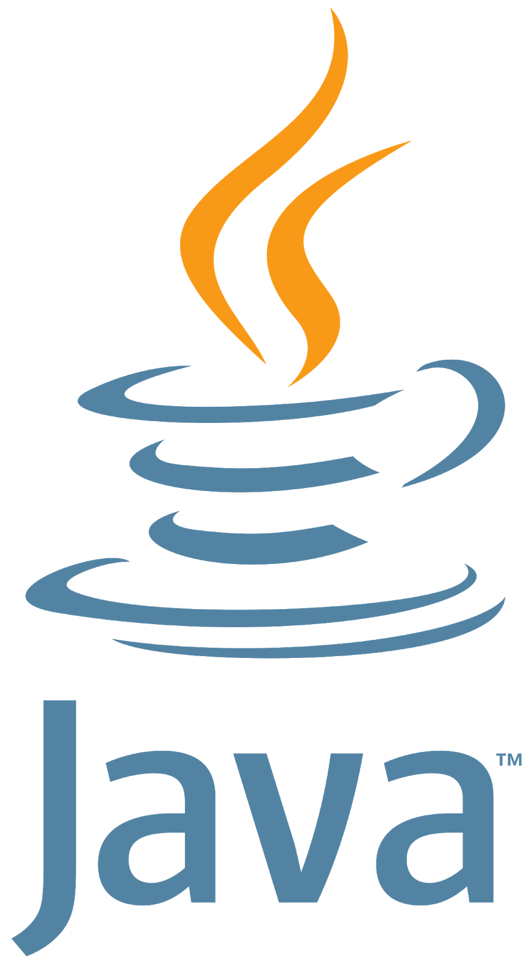





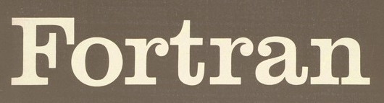
There’s a plethora of programming languages

Slide 24
There’s a plethora of programming languages

Slide 25
There’s a plethora of programming languages
Slow(ish)
Fast

Slide 26
There’s a plethora of programming languages
Compiled
Interpreted

Slide 27
There’s a plethora of programming languages
Static
Dynamic

Slide 28
There’s a plethora of programming languages
Speed
Convenience

Slide 29
The “two language problem”
a.k.a Ousterhout's dichotomy
Prototype
Production

Slide 30
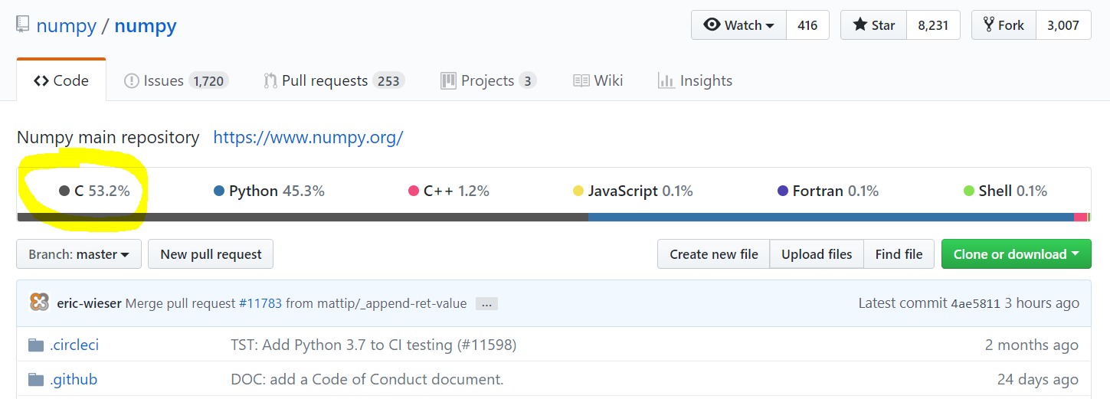
The “two language problem”

Slide 31



The “two language problem”
User
Developer

Slide 32
The “two language problem”
static
dynamic
compiled
interpreted
user types
standard types
standalone
glue

Slide 33
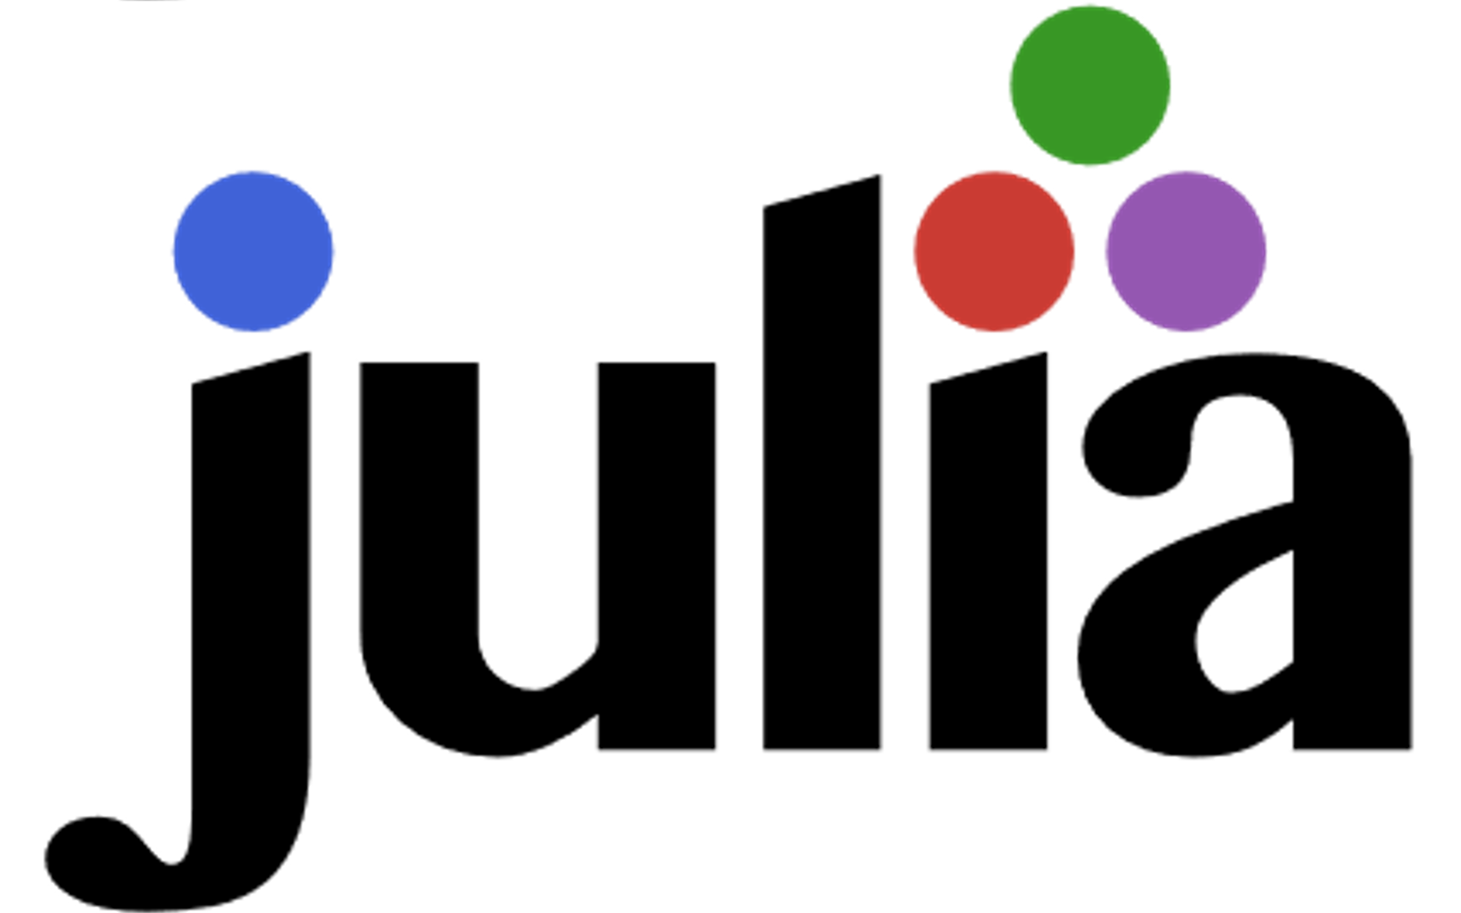
dynamic
compiled
user types
and
standard types
standalone
or
glue

Slide 34
What do we want from a PL?
The unification
Simple yntax + grammar
Expressive
Fast
Interactive

Slide 35
What do we want from a PL?
The unification
function babylonian(α; N = 10)
@assert α > 0 "α must be > 0"
t = (1+α)/2
for i = 2:N
t = (t + α/t)/2
end
t
end
babylonian(π) ≈ √π
Expressive
Fast
Interactive
“Feels like Python, runs like C”

Slide 36
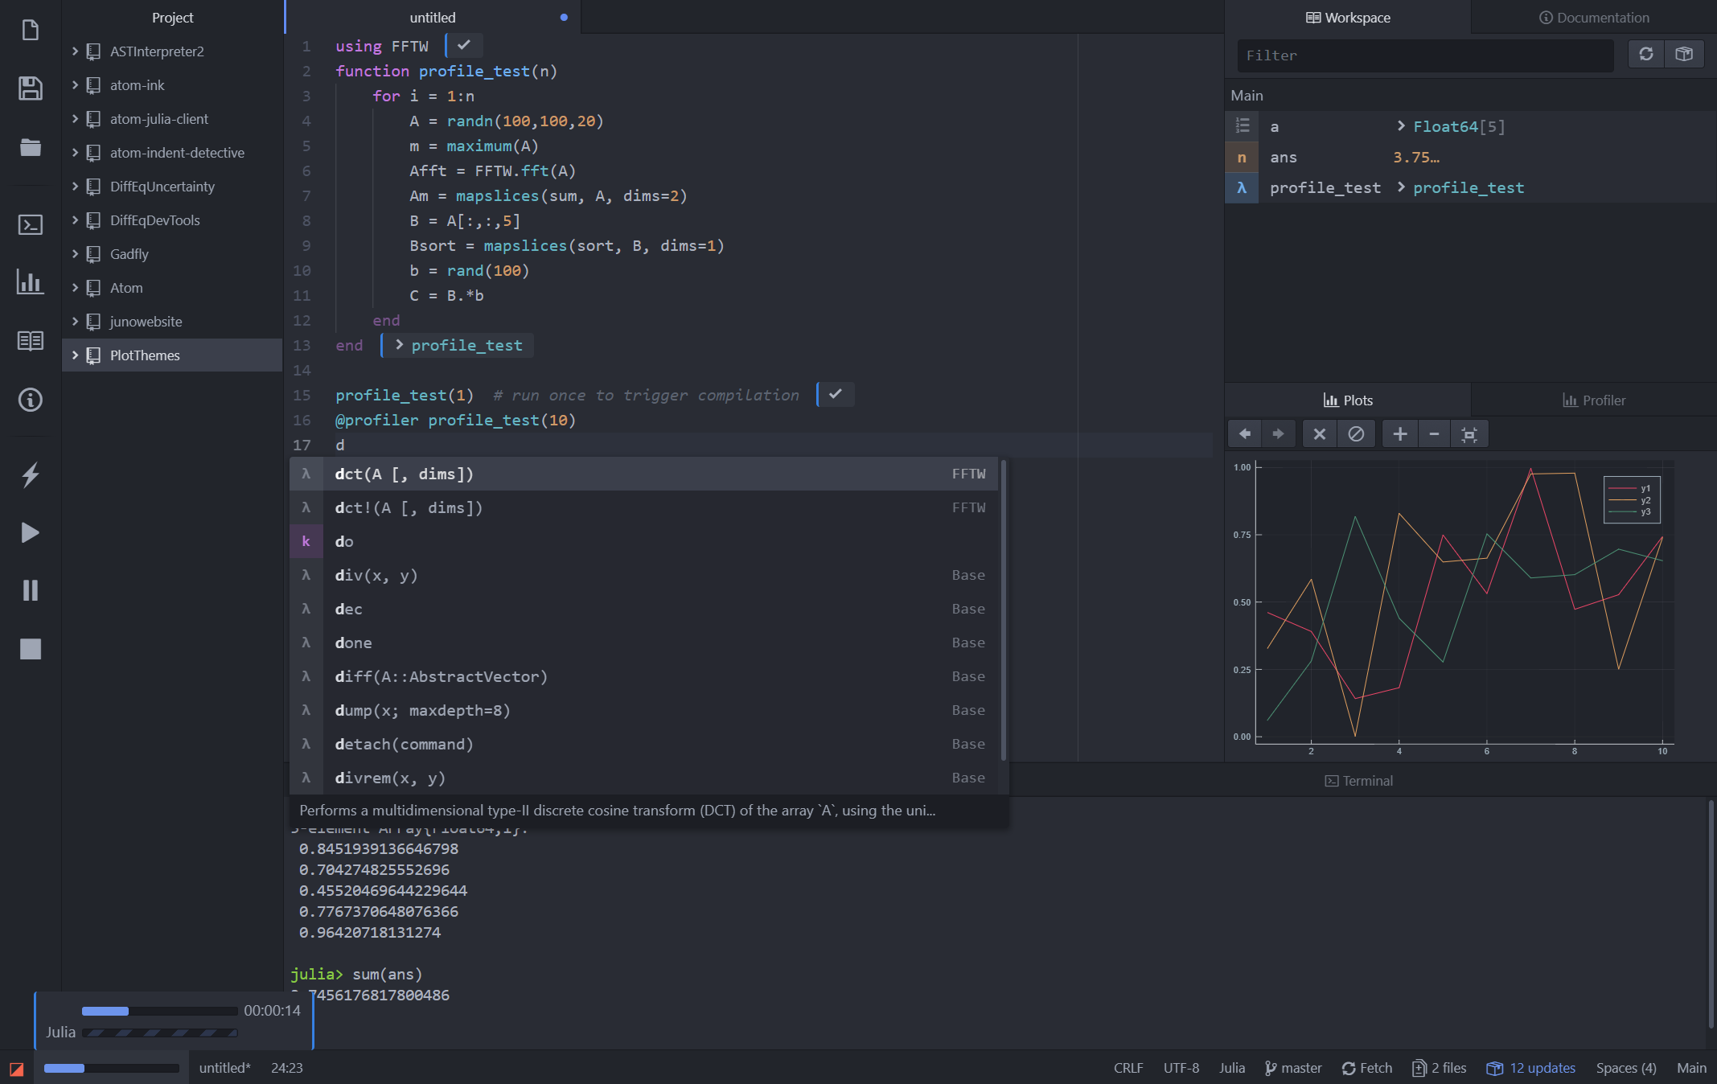
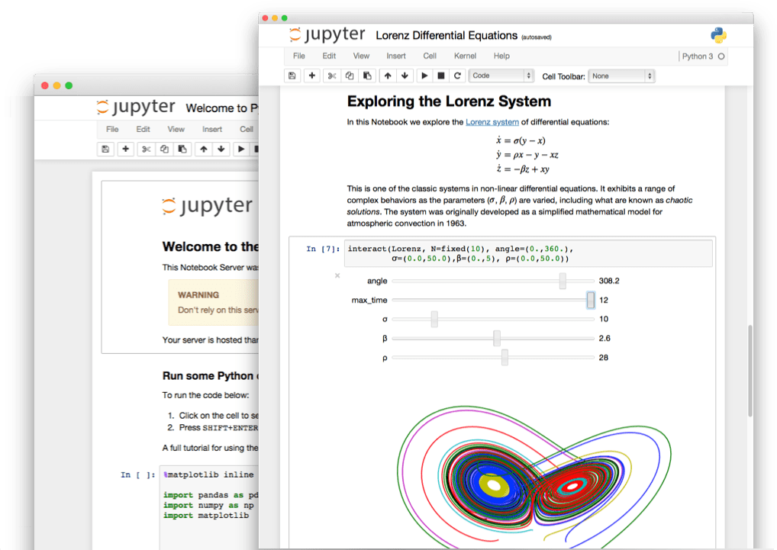
What do we want from a PL?
The unification
Simple yntax + grammar
Expressive
Fast
Interactive
“Feels like Python, runs like C”

Slide 37
What do we want from a PL?
The unification
julia> function sumup()
x = 0
for i in 1:100
x += i
end
x
end
sumup (generic function with 2 methods)
julia> @code_llvm debuginfo=:none sumup()
; Function Attrs: uwtable
define i64 @julia_sumup_12626() #0 {
top:
ret i64 5050
}
Simple yntax + grammar
Expressive
Fast
Interactive
Just returns the answer!
(The for loop was compiled away)
“Feels like Python, runs like C”

Slide 38
Python
Matlab
Runtime
Julia
C++
C
Fortran
Code complexity

Slide 39
Expressive & fast
Python
Matlab
Julia
Fortran
Runtime
C
C++
Code complexity

Slide 40
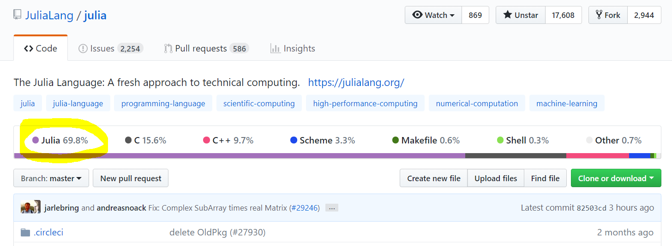
Free and open source

Slide 41

Inviting
User
Developer

Slide 42
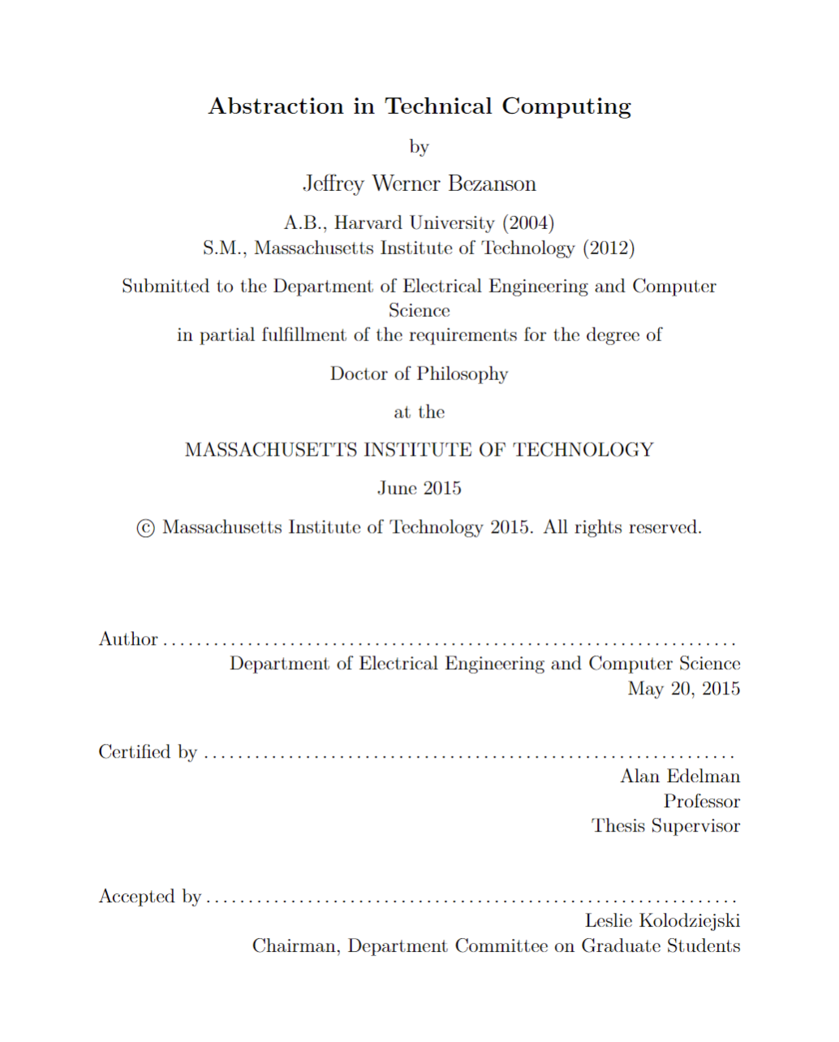
How old is Julia?
2009 Jeff, Stefan, Viral, and Alan start working on Julia
2012 Blog post: Why we created Julia
2015 Jeff’s PhD & JuliaComputing
2018 Julia 1.0
Founders talk @ JuliaCon 2018: https://www.youtube.com/watch?v=1jN5wKvN-Uk

Slide 43

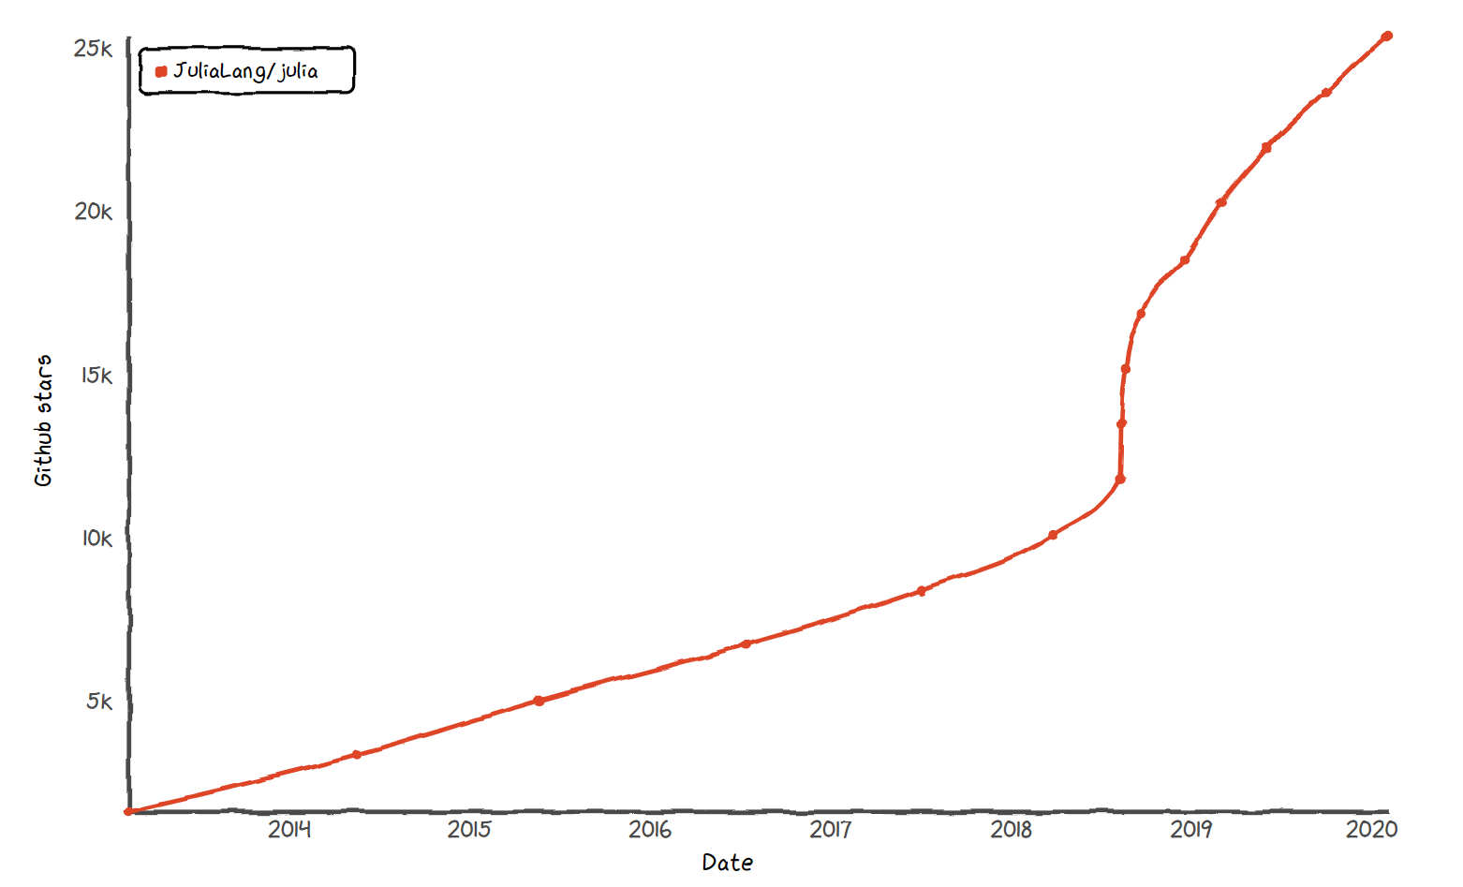
Julia stars
* Base language, does not include packages

Slide 44
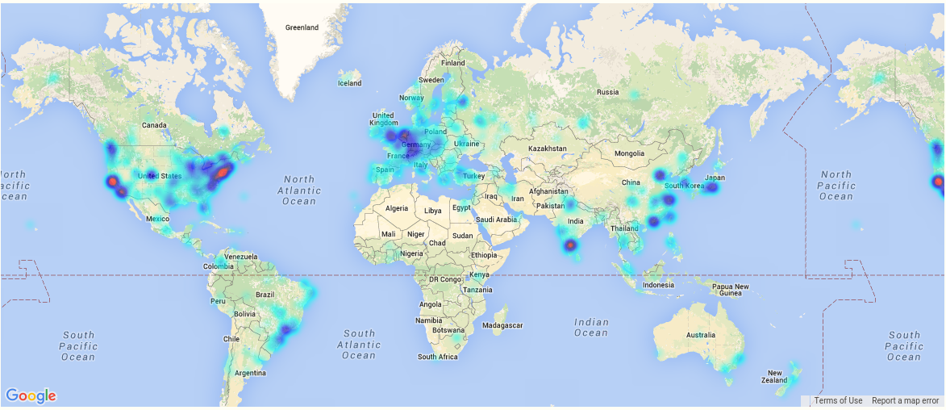
A global community
More than 12 Million downloads, >3000 packages

Slide 45
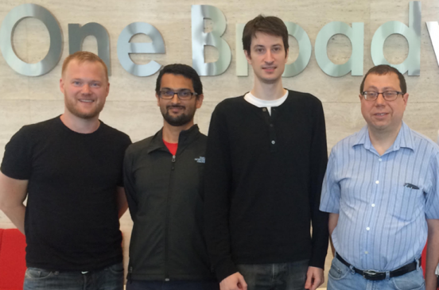

James H. Wilkinson Prize
For Numerical Software
Forbes
30 under 30
IEEE Babbage Prize
IEEE Fellow
Stefan Karpinski
Viral B. Shah
Jeff Bezanson
(2019)
Keno Fischer
(2019)
Prof. Alan Edelman
(2018)

Slide 46































Notes:
Universities teaching Julia

Slide 47

Notes:
Universities teaching Julia

Slide 48
Let’s get started!

